Slide 1
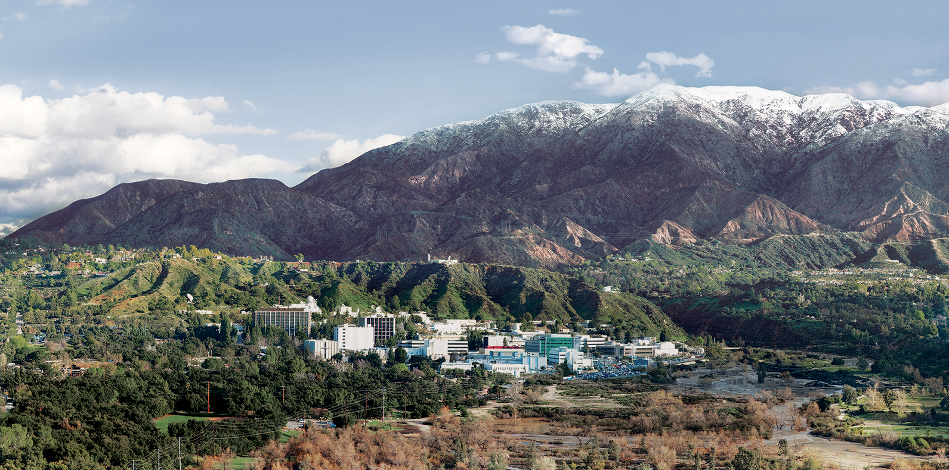
9. The Atmosphere
Dr. David R. Thompson
Jet Propulsion Laboratory, Imaging Spectroscopy Group

Slide 2
Goals for this module
Use precise definitions for reflectance quantities
Estimate water vapor concentrations with continuum-interpolated band ratios
Understand classical atmospheric correction routines

Slide 3

Spectral Surface Reflectance
The surface reflectance represents the fraction of incident light reflected in every wavelength.
Aerosols
(absorption and scattering)
Atmospheric gases
(absorption)
Surface reflectance

Slide 4
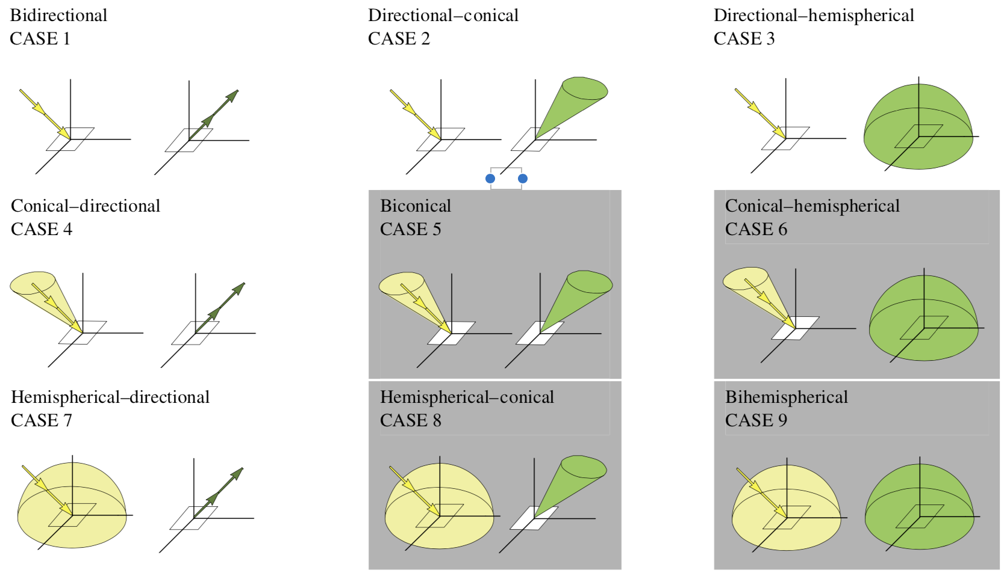
Spectral Surface Reflectance
“Reflectance” is a generic term and can refer to many different physical quantities. The reflected fraction is dependent on the angle of incoming and outgoing light. This defines 9 different reflectance quantities depending on whether we are describing properties of an infinitesimal ray, conical area, or hemisphere. [Schaepman-Strub 2006]

Slide 5
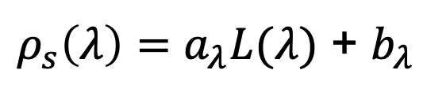
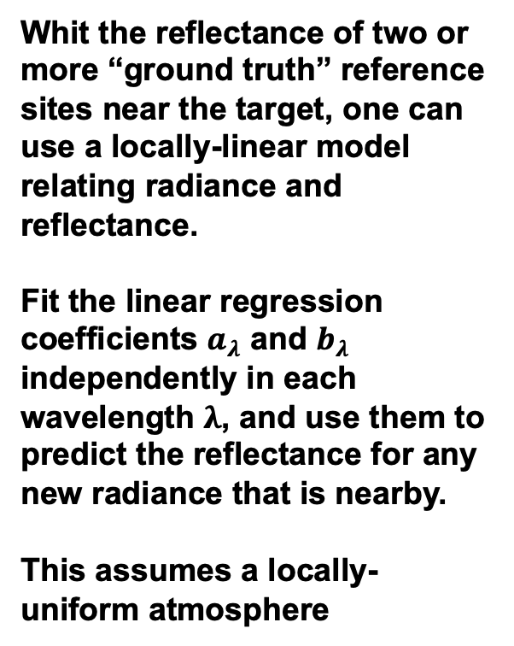
The Empirical Line approach
Whit the reflectance of two or more “ground truth” reference sites near the target, one can use a locally-linear model relating radiance and reflectance.
Fit the linear regression coefficients $a_{λ}$ and $b_{λ}$ independently in each wavelength $λ$, and use them to predict the reflectance for any new radiance that is nearby.
This assumes a locally-uniform atmosphere
reflectance
radiance
$ρ_{s}\left(λ\right)=a_{λ}L(λ)$ + $b_{λ}$
Ground truth points
Reflectance at 550 nm
New Radiance
Radiance at 550 nm

Slide 6
Physics-Based Atmospheric correction
Ground reference data is not always available near the target surfaces. Consequently, the most common atmospheric correction methods use physical models to predict atmospheric distortions. Since atmospheric properties vary over short spatial scales, this requires estimating some components (such as water vapor) directly from the data.
“AVIRIS Classic” imaging spectrometer, visible wavelengths
Retrieved Water vapor
[Thompson et al., Surv. Geophys. 2019]
Notes:
Spatiotemporal variability means we must estimate the atmosphere independently in each spectrum.

Slide 7
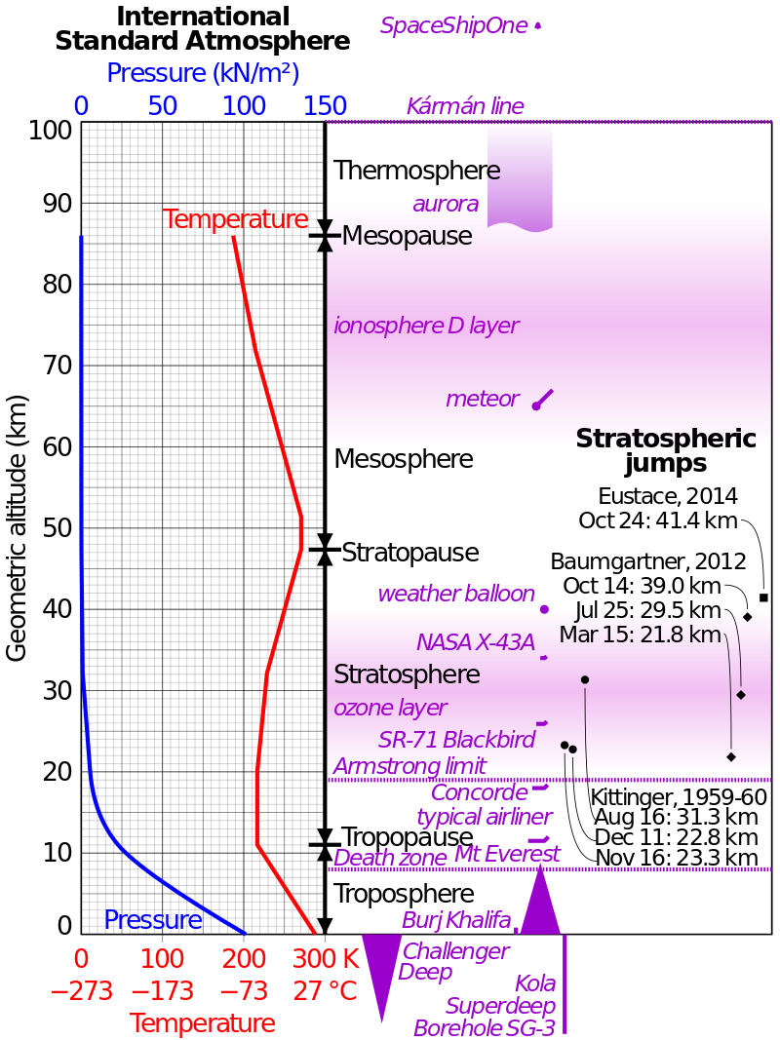
Atmospheric models
Typically a stack of homogeneous layers representing vertical distributions of temperature, pressure, the abundance of atmospheric gases and particle aerosols.
Some gases are well-mixed in the atmosphere (e.g. O₂) while others may be localized.
Most water vapor is here
[Thompson et al., Surv. Geophys. 2019]
Atmospheric gas absorptions

Slide 8
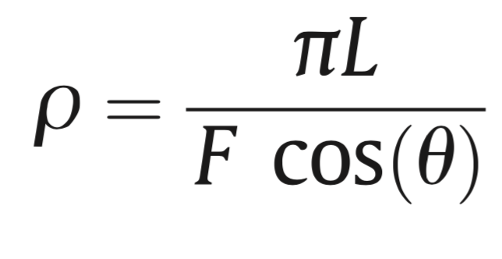
Top of Atmosphere (TOA) reflectance
For convenience, we transform the radiances into a TOA reflectance quantity – the apparent “reflectance” of the Earth and atmosphere, which normalizes out variability in the solar illumination
Radiance at sensor
Solar irradiance
Solar zenith angle

Slide 9
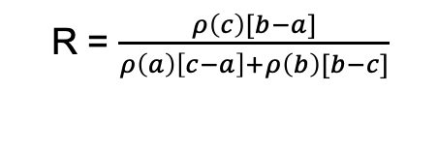
Estimating “band depths”
The depth of a gas absorption feature is related to its abundance along the optical path from sun, to ground, to sensor. This quantity can be used to estimate the amount of a variable gas like H₂O vapor.
A classic approach, the continuum-interpolated band ratio, draws a line across the absorption feature and then measures the depth relative to the continuum. It is written:
b
a
c
R = $\frac{ρ\left(c\right)[b−a]}{ρ\left(a\right)\left[c−a\right]+ρ\left(b\right)[b−c]}$

Slide 10
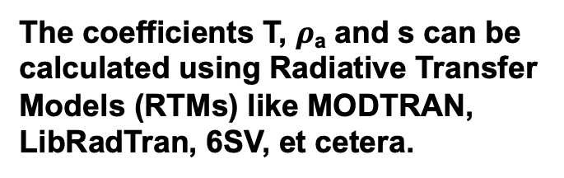
Decoupled RTM approximation
For a Lambertian surface, the TOA reflectance can be written using the following relationship.
[Thompson et al., 2018]
Transmittance
Surface reflectance
Path reflectance
Spherical albedo
Aerosols
(absorption and scattering)
The coefficients T, $ρ$_{a} and s can be calculated using Radiative Transfer Models (RTMs) like MODTRAN, LibRadTran, 6SV, et cetera.
H₂O column vapor
(absorption)
Surface reflectance

Slide 11
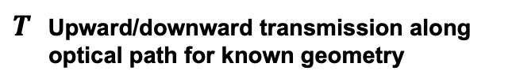
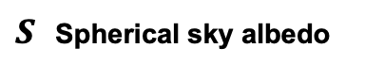
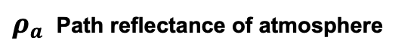
“Classic” atmospheric correction
Lookup table indexed by H₂O, etc.
1. In advance, do RTM calculations for a grid of atmospheric conditions:
$ρ_{a}$ Path reflectance of atmosphere
$S$ Spherical sky albedo
$T$ Upward/downward transmission along optical path for known geometry
Notes:
With atmospheric state specified, We can get optical constants via linear lookup table interpolation (note: T=transmission, S=spherical sky albedo, rho_a is the path reflectance).
This is just one of several similar functional approximations to the actual radiative transfer solution. With atmosphere specified, we can invert it algebraically to recover the surface reflectance.
The conventional strategy is limited in sever

Slide 12
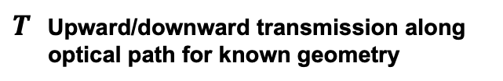
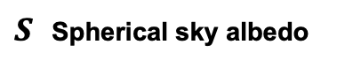
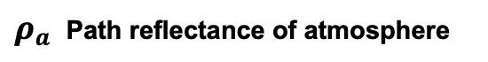
“Classic” atmospheric correction
2. Analyze radiance to estimate this atmosphere (typically using band ratios).
Lookup table indexed by H₂O, etc.
1. In advance, do RTM calculations for a grid of atmospheric conditions:
$ρ_{a}$ Path reflectance of atmosphere
$S$ Spherical sky albedo
$T$ Upward/downward transmission along optical path for known geometry
Notes:
With atmospheric state specified, We can get optical constants via linear lookup table interpolation (note: T=transmission, S=spherical sky albedo, rho_a is the path reflectance).
This is just one of several similar functional approximations to the actual radiative transfer solution. With atmosphere specified, we can invert it algebraically to recover the surface reflectance.
The conventional strategy is limited in sever

Slide 13
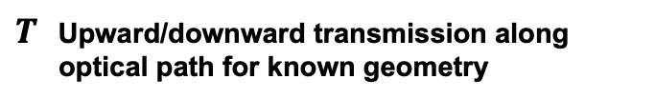
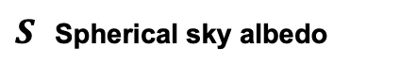
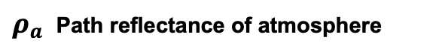
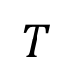
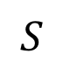
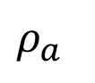
“Classic” atmospheric correction
2. Analyze radiance to estimate this atmosphere (typically using band ratios).
3. Look up and/or interpolate optical coefficients
Lookup table indexed by H₂O, etc.
$ρ_{a}$
$$S$$
$$T$$
1. In advance, do RTM calculations for a grid of atmospheric conditions:
$ρ_{a}$ Path reflectance of atmosphere
$S$ Spherical sky albedo
$T$ Upward/downward transmission along optical path for known geometry
Notes:
With atmospheric state specified, We can get optical constants via linear lookup table interpolation (note: T=transmission, S=spherical sky albedo, rho_a is the path reflectance).
This is just one of several similar functional approximations to the actual radiative transfer solution. With atmosphere specified, we can invert it algebraically to recover the surface reflectance.
The conventional strategy is limited in sever

Slide 14
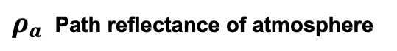
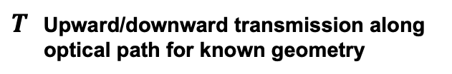
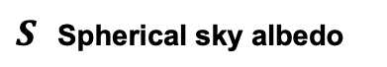
“Classic” atmospheric correction
2. Analyze radiance to estimate this atmosphere (typically using band ratios).
3. Look up and/or interpolate optical coefficients
Surface reflectance
TOA reflectance
Lookup table indexed by H₂O, etc.
4. Algebraic Inversion
1. In advance, do RTM calculations for a grid of atmospheric conditions:
$ρ_{a}$ Path reflectance of atmosphere
$S$ Spherical sky albedo
$T$ Upward/downward transmission along optical path for known geometry
Notes:
With atmospheric state specified, We can get optical constants via linear lookup table interpolation (note: T=transmission, S=spherical sky albedo, rho_a is the path reflectance).
This is just one of several similar functional approximations to the actual radiative transfer solution. With atmosphere specified, we can invert it algebraically to recover the surface reflectance.
The conventional strategy is limited in sever

Slide 15
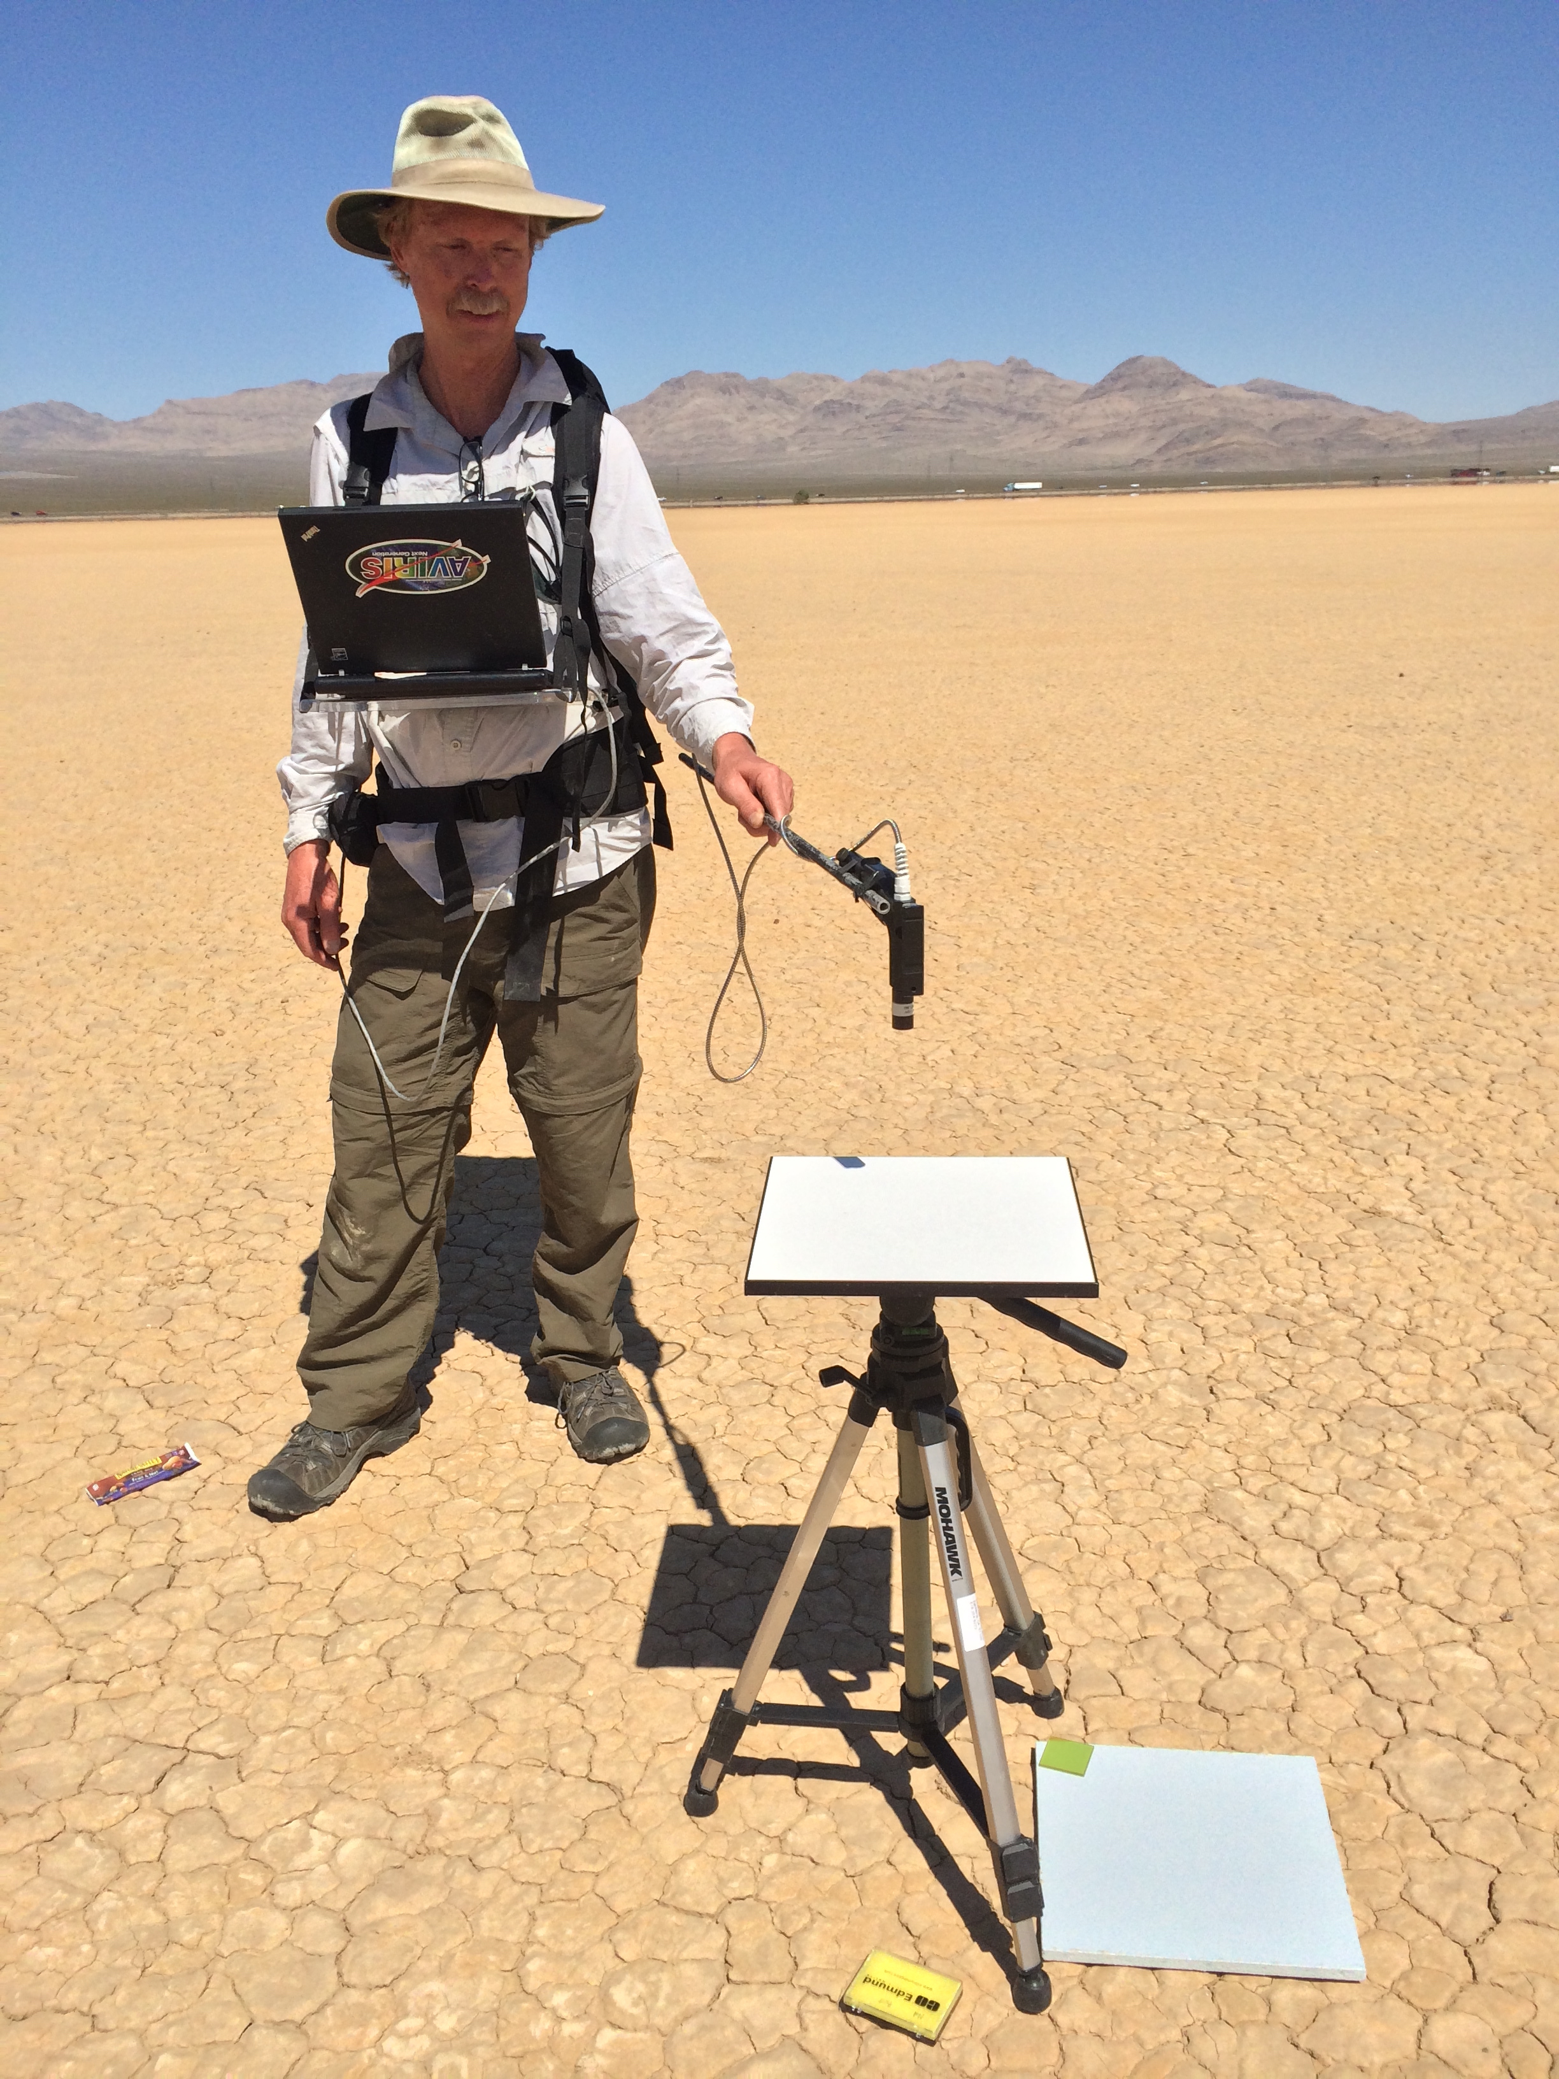
Validating atmospheric correction
Typical validation experiments involve constraining the terms in the TOA reflectance equation by measuring the surface and atmospheric aerosols in-situ, and then simulating the measurement at sensor. Equivalently, one can invert the radiance using retrieved or measured atmospheres, and evaluate the match with in-situ reflectances. 2-4% error is typical.
Scott Nolte, JPL
[Thompson et al., Surv. Geophys. 2019]
Notes:
Posterior uncertainty predictions (grey envelopes) accurately predict and capture our actual discrepancies!
This demonstrates a closed account of the uncertainty in the system. To our knowledge, this is the first time it has been done for VSWIR imaging spectroscopy.
Note: we also account for the uncertainty in the surface measurement, which is a significant contributor to the confidence bands.

Slide 16
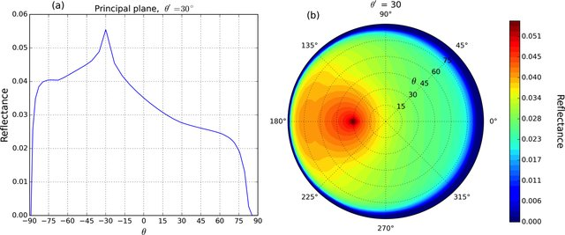
Beyond Lambertian surfaces
The algebraic formulation assumes the surface is Lambertian, i.e. reflectance is the same in all directions. More sophisticated angle-dependent models exist. They are particularly useful for complex surfaces like vegetation. Below: the Ross-Li Vegetation BRDF.
Image: Ross-Li kernel from Lorente et al., The importance of surface reflectance anisotropy for cloud and NO2 retrievals from GOME-2 and OMI, July 2018 Atmospheric Measurement Techniques 11(7):4509-4529

Slide 18
Exercise 8: Empirical Line Atmospheric Correction
Objective: Find the reflectance of objects in an overflight of the Jet Propulsion Laboratory, using the Empirical Line Technique.
Four targets at the Jet Propulsion Laboratory were measured in situ with field spectrometers. Later that day, the AVIRIS-NG imaging spectrometer overflew the same site. We have extracted radiances and reflectances at each location.
Fit an empirical line model to the first three sites, and then use that information to predict the reflectance at the fourth site. How close did you get?

